Slide 1





YOUR School NAME HERe
The Georgia Promise Scholarship Act
School cycle 2026-2027

Slide 2




What is The Georgia Promise Scholarship Act?
The Georgia Promise scholarship is an education choice program. The program will provide eligible students with the opportunity to use public funds for non-public education expenses in grades kindergarten through 12th grade.
For the first year of the program (the 2025 – 2026 academic year), the scholarship amount is set by law at a maximum of $6,500.

Slide 3



How It Works

Slide 4





What does it Cover?
Tuition and fees
Required textbooks, curriculum, and approved supplemental materials
Tutoring services provided by a Georgia Professional Standards Commission–certified educator
Services from a physician or licensed therapist, including occupational, behavioral, physical, or speech-language therapy

Slide 5



Who is Eligible?
For the 2026-2027 school year, your child may qualify if he or she is:
Are enrolled in a GA public school for the 2025-2026 school year OR entering kindergarten in 2026-2027.
Are zoned for an underperforming high school, middle school, or elementary school (even if not yet attending).
Have parents who have lived in Georgia for at least one year (exceptions for active-duty military).

Slide 6



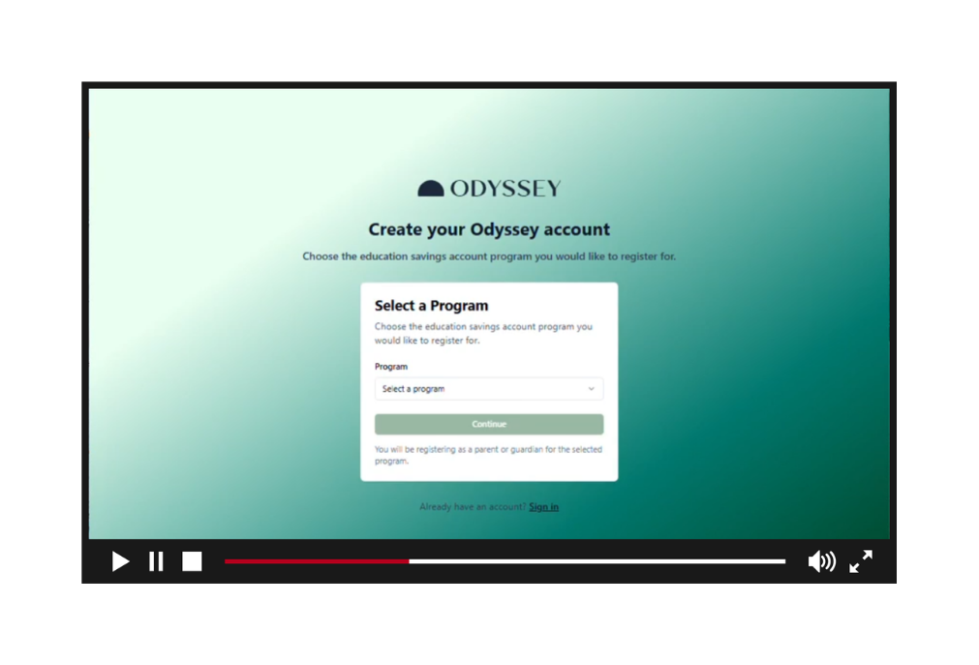

What do I need to apply?
Georgia Promise Scholarship Program Application Process Overview Video

Slide 7



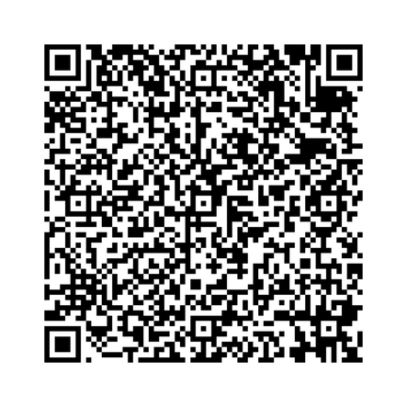


Georgia Promise Scholarship Website

Slide 8





Who Can Help Me?
(Include your school information here)
School Admin 1
(555) 555-5555
School Admin 2
(555) 555-5555

Slide 9




IMPORTANT DATES TO SAVE
March 1st - 31st
First application window for the 2026/27 academic year opens.
May 1st - 31st
Second application window for the 2026/27 academic year opens.

Slide 10





More Questions?
(Include your school information here)
Contact Us
+123-456-2890
hello@reallygreatsite.com
www.reallygreatsite.com
Georgia Promise Scholarship
Contact our Odyssey Support Team
help@mygeorgiapromise.org
470-470-7057

