Slide 1





YOUR School NAME HERe
The Louisiana Giving
All True Opportunity
to Rise (LA GATOR)
School cycle 2026-2027

Slide 2




What is The Louisiana Giving All True Opportunity to Rise (LA GATOR)?
The Louisiana Giving All True Opportunity to Rise (LA GATOR) Scholarship Program, created by Act 1 of the 2024 Louisiana Legislature and signed into law by Governor Jeff Landry, provides eligible families with education scholarship accounts (ESAs).
These accounts allow families to personalize their child’s education by using state funds for approved education expenses, such as nonpublic school tuition and fees, tutoring, educational therapies, textbooks, curricula, dual enrollment courses, and uniforms.

Slide 3



How It Works

Slide 4



What does it Cover?
  Tuition and fees at participating nonpublic schools or online learning programs
  Curricula, textbooks, and instructional materials (including online and supplemental materials)
  Tuition, fees, materials, and exam costs for career and technical schools
  Fees for approved assessments (AP, CLEP, IB, and college admission exams)
  Educational services and therapies (occupational, behavioral, physical, speech-language, audiology)
  Dual enrollment tuition and fees at postsecondary institutions
  Tutoring services
  Classes, extracurricular activities, and programs through participating public schools
  Computer hardware and technology devices used for educational purposes
  Educational software applications
  School uniforms
  Summer programs and before/after-school academic or childcare programs
  Parent navigation services (guidance on school selection, enrollment, curriculum, and career pathways)
  Other educational supplies or approved expenses (as determined by BESE)

Slide 5




Who is Eligible?
To be eligible for the LA GATOR Scholarship Program, a student must:
Live in Louisiana
Be at least 5 years old (but not older than 21) by September 30, 2026
Meet one of the following:
    Participated in the LA GATOR Scholarship Program during the 2025–2026 school year
    Is entering kindergarten
    Was enrolled in a public school on both October 1 and February 1 of the 2025–2026 school year
    Comes from a household with income at or below 250% of the federal poverty level
Eligibility must be reverified each year to continue in the program.

Slide 6





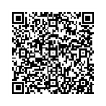
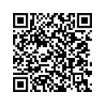
What do I need to apply?
Returning Students: How to Complete the 26-27 Program Application
New Students: How to Complete the 26-27 Program Application

Slide 7



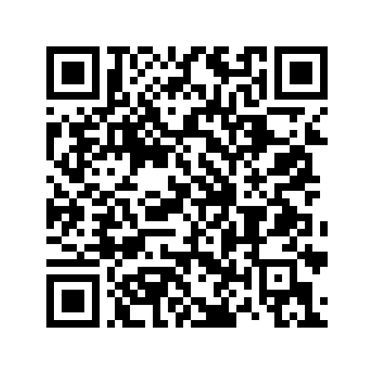


The Louisiana Giving All True Opportunity to Rise (LA GATOR) Website

Slide 8





Who Can Help Me?
(Include your school information here)
School Admin 1
(555) 555-5555
School Admin 2
(555) 555-5555

Slide 9




IMPORTANT DATES TO SAVE
March 1-16
For Returning Students: The LA GATOR Scholarship Program application window for the 2026–2027 school year opens Sunday, March 1 at 9 a.m. CT and closes March 16 at 11:59 p.m. CT.
April–June
The Louisiana Legislature will decide how much funding the program receives for 2026–27
June-July (estimated)
Award notifications will be sent through the Odyssey platform.
Summer 2026
Families who receive awards will set up their student’s account and can begin selecting schools and services.

Slide 10





More Questions?
(Include your school information here)
Contact Us
+123-456-2890
hello@reallygreatsite.com
www.reallygreatsite.com
Submit a Help Desk Ticket
Email: help.la@withodyssey.com
Call: 225-422-1538

