Slide 1





YOUR School NAME HERe
Missouri Empowerment Scholarship Accounts Program (MO Scholars)
School cycle 2026-2027

Slide 2




What is Missouri Empowerment Scholarship Accounts Program (MO Scholars)?
In 2021, the Missouri General Assembly passed HB349 and SB86 which established the Missouri Empowerment Scholarship Accounts Program, MOScholars. The law provides state tax credits for contributions to approved, non-profit Educational Assistance Organizations (EAOs).
Up to $7,145 approximate annual average per student.
These EAOs use the contributions to award scholarships to Missouri students with Individual Education Plans (IEPs) and students living in low-income households.

Slide 3



How It Works

Slide 4





What does it Cover?
Tuition + fees at private school, public school Classes
Virtual school textbooks & curriculum
Educational therapies
Tutoring
Transportation
Certain approved technology devices
Extracurricular activities, including after school programs and summer education programs

Slide 5



Who is Eligible?
Student Eligibility
  Must meet requirements under Missouri Revised Statutes 166.700(9)
  Must meet one of the following criteria:
Students with Disabilities
  Have an approved Individualized Education Program (IEP) under IDEA
  (Students with ISPs not developed under IDEA are not eligible)
Income-Based Eligibility
  Household income at or below 300% of the free and reduced lunch threshold, and meet at least one of the following:
    Attended a public school full-time for at least one semester in the past 12 months
    Eligible to begin kindergarten or first grade
    Sibling of a current or previous scholarship recipient
  Income eligibility guidelines are set annually by the federal government (see link for details)

Slide 6





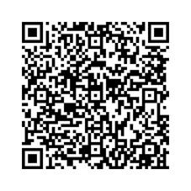
What do I need to apply?
INSTRUCTIONS FROM THE MISSOURI STATE TREASURER HOW TO APPLY FOR YOUR CHILD

Slide 7



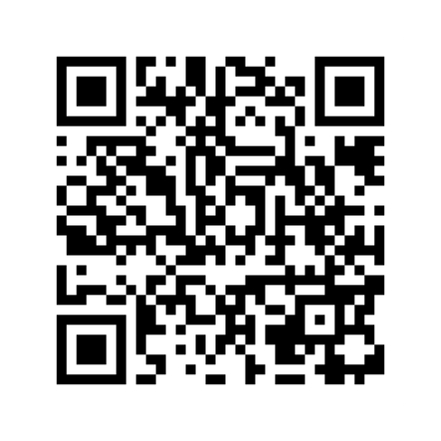


Missouri Empowerment Scholarship Accounts Program (MO Scholars) Website

Slide 8



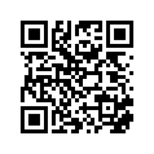

IMPORTANT DATES TO SAVE
Application Period Opens:
Typically opens early in the year (varies by scholarship organization)
Application Deadlines:
Deadlines vary by organization — families are encouraged to apply as early as possible

Slide 9





Who Can Help Me?
(Include your school information here)
School Admin 1
(555) 555-5555
School Admin 2
(555) 555-5555

Slide 10





More Questions?
(Include your school information here)
Contact Us
+123-456-2890
hello@reallygreatsite.com
www.reallygreatsite.com
MISSOURI STATE TREASURER
Email: Contact the State Treasurer's Office
Call: (573) 751-8533

