Slide 1





YOUR School NAME HERe
EDUCATION SCHOLARSHIP TRUST FUND PROGRAM
School cycle 2026-2027

Slide 2




What is The EDUCATION SCHOLARSHIP TRUST FUND PROGRAM?
The Education Scholarship Trust Fund Program is administered by the South Carolina Department of Education that allows qualifying South Carolina families to apply for a scholarship. For the 2025-2026 school year, the award amount is $7,500.
For the 2026-2027 school year, the awarded amount will be $7,634.

Slide 3



How It Works

Slide 4





What does it Cover?
Tuition and fees
Required textbooks, curriculum, and approved supplemental materials
Tutoring services provided by a Georgia Professional Standards Commission–certified educator
Services from a physician or licensed therapist, including occupational, behavioral, physical, or speech-language therapy
Transportation to and from approved service providers (up to $500 annually)

Slide 5



Who is Eligible?
For the 2026-2027 school year, your child may qualify if he or she is:
Be a resident of South Carolina;
Be in kindergarten through 12th grade (not exceeding age 22);
Have a household income that does not exceed 500% of the federal poverty guidelines. For priority application status, household income must not exceed 300% of the federal poverty guidelines (~$96,450 for a family of four in 2025)

Slide 6




What do I need to apply?
Proof of guardianship (tax return with dependents listed, birth certificate, etc.)
Proof of income (2023 or 2024 tax return documentation. If you don’t file taxes, you’ll need to provide other documentation of your household income)
Proof of residency (driver’s license or state-issued ID, utility bill, etc.)

Slide 7



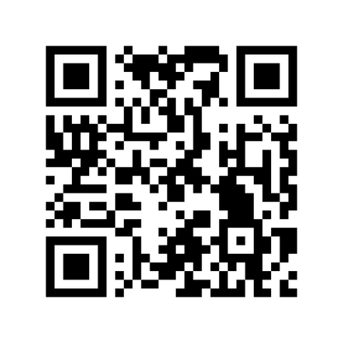


EDUCATION SCHOLARSHIP TRUST FUND PROGRAM Website

Slide 8





Who Can Help Me?
(Include your school information here)
School Admin 1
(555) 555-5555
School Admin 2
(555) 555-5555

Slide 9




IMPORTANT DATES TO SAVE
November 1st, 2025
Students can renew for the 2026-2027 school year; their siblings may also apply.
January 15th, 2026
Applications open for priority groups:
    Siblings of current ESTF students,
    Children of active duty military,
    Students residing in a household with an income of less than 300% of the federal poverty guidelines (~$96,450 for a family of four),
    Students who attended public school in 2025.
February 9th, 2026
All other students earning between 300% and 500% of the federal poverty guidelines (~$96,451 – $160,750 for a family of four in 2025)
At this time, the Education Scholarship Trust Fund Program has reached its maximum capacity of 15,000 awarded students for 2026-2027. Families can register for the 2026-2027 waitlist.

Slide 10





More Questions?
(Include your school information here)
Contact Us
+123-456-2890
hello@reallygreatsite.com
www.reallygreatsite.com
CLASSWALLET AND FAMILY APPLICATION SUPPORT
help@classwallet.com
(877) 313-1299

