Slide 1





YOUR School NAME HERe
Tennessee Education
Freedom Scholarships
School cycle 2026-2027

Slide 2




What is the Education Freedom ScholarshiP?
Education Freedom Scholarships (EFS) allow students who are entitled to attend a Tennessee public school in grades K-12 to use state funds for education expenses while enrolled in an EFS-registered Category I, II, or III non-public school located in Tennessee, prioritizing expenses for tuition and fees.

Slide 3



How It Works

Slide 4





What does it Cover?
Private school tuition or Fees
Textbooks
Tutoring
Courses associated with nationally
standardized assessments
Transportation

Slide 5



Who is Eligible?
For the 2025-2026 school year, your child may qualify if he or she is:
Student is Tennessee resident who is a U.S. citizen or lawfully present in the United States
Student will have completed fewer than 13 years of school in K-12 at the beginning of the 2026- 27 school year

Slide 6




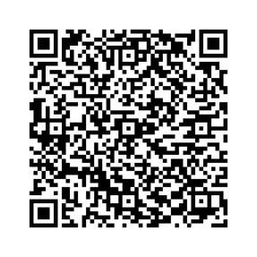
What do I need to apply?
Two proofs of Tennessee residency
One proof of child’s U.S. citizenship OR two proofs of lawful presence in the U.S.

Slide 7



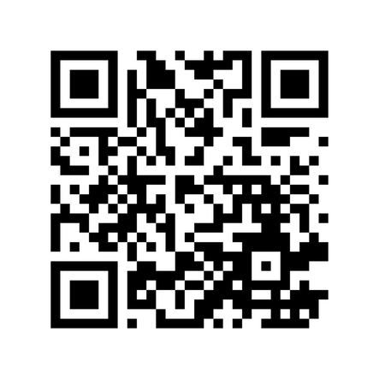


TN DoE’s EFS Website

Slide 8





Who Can Help Me?
(Include your school information here)
School Admin 1
(555) 555-5555
School Admin 2
(555) 555-5555

Slide 9




IMPORTANT DATES TO SAVE
January 13th
Applications Open for New Students
February 6th
Applications close.

Slide 10





More Questions?
(Include your school information here)
Contact Us
+123-456-2890
hello@reallygreatsite.com
www.reallygreatsite.com

