Slide 1





YOUR School NAME HERe
Texas Education Freedom Accounts (TEFA)
School cycle 2026-2027

Slide 2




What is The Texas Education Freedom Accounts (TEFA)?
Texas Education Freedom Accounts (TEFA) is a state-funded program that gives parents more freedom and flexibility in choosing the best education for their children. Families who enroll their children in private school or home education and are accepted into the program can use TEFA funds to pay for approved education-related expenses.

Slide 3



How It Works

Slide 4





What does it Cover?
Education Expenses
Private school tuition & fees
Online courses & approved training programs
Textbooks & instructional materials
Required uniforms
Eligible school district classes
Other Approved Expenses
  Academic assessments & private tutoring
  Transportation to/from approved providers
  Educational therapies (not covered by Medicaid or other programs)
  Computer hardware or software
  Meals provided by a private school

Slide 5



Who is Eligible?
Are a U.S. citizen, national, or lawfully admitted
Are eligible to attend a Texas public or charter school (including Pre-K or Kindergarten)
Reside in Texas

Slide 6



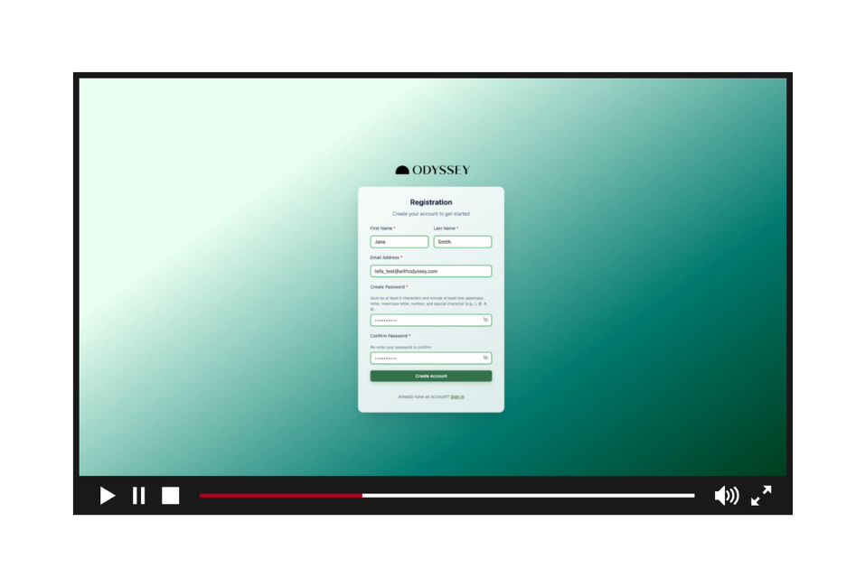


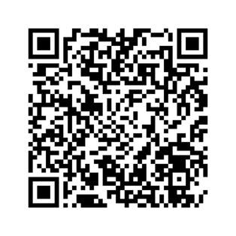
What do I need to apply?

Slide 7



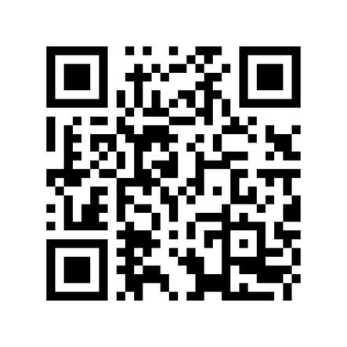


Texas Education Freedom Accounts (TEFA) Website

Slide 8





Who Can Help Me?
(Include your school information here)
School Admin 1
(555) 555-5555
School Admin 2
(555) 555-5555

Slide 9



IMPORTANT DATES TO SAVE
February 4 – March 31, 2026.
The application window runs
April 2026
Funding notifications will be sent to parents beginning
July 1, 2026
At least 25 percent of approved funding will be available in participant accounts.
October 1, 2026
At least 50 percent of approved funding will be available in participant accounts.
April 1, 2027
Remaining funding will be available in participant accounts.

Slide 10





More Questions?
(Include your school information here)
Contact Us
+123-456-2890
hello@reallygreatsite.com
www.reallygreatsite.com
Odyssey support website
Call: 737-379-2362

